Slide 1
chat GPT

Slide 2
Perceptron 1957
Neural Networks
Deep Learning
Artificial Intelligence 1950
Machine learning
DeepMind
2010
ImageNet Challenge 2012
Google
2014
TensorFlow 2015
OpenAI
2015 Elon Musk
AlphaGo 2016
AlphaZero 2017
Twitter
2021
Transformer 2018
Microsoft
2019
Bard
2023
chat GPT
2018~
x.AI
2023

Slide 3
Key Words
Artificial intelligence
Machine Learning
Deep Learning = multiple neural networks
Large Language model (LLM)
Transformer
Training

Slide 4
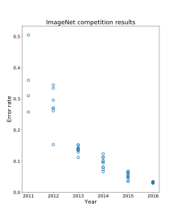
ImageNet - Wikiwand

Slide 5
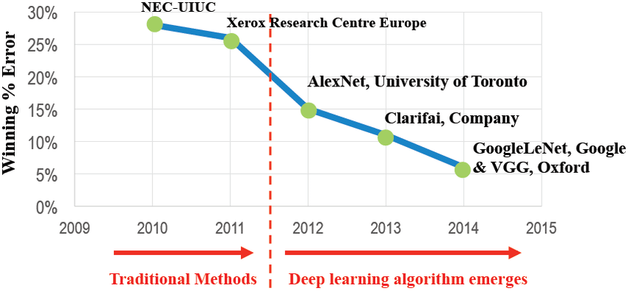
ImageNet Competition Results
https://www.researchgate.net/figure/ImageNet-Competition-Results-50_fig1_329975404

Slide 6

2015
Chat GPT-1 – 2018
Chat GPT-2 – 2019
Chat GPT-3 – 2020
Chat GPT3X – 2022

Slide 7
Feature | AlphaGo 2016 | AlphaZero 2017
Training data | CPU 30 million human Go games Machine learning | GPU (TPU) Self-play Go games Deep Learning
Neural network architecture | Two-network | Single-network
Monte Carlo tree search | MCTS | MCTS with modifications
Peak Elo rating | 3,900 | 4,823
Versatility | Can only play Go | Can play Go, chess, and shogi

Slide 8
Elo rating system
It is a numerical rating system that was originally invented by Arpad Elo, a Hungarian-American physics professor and chess player.
The Elo rating system is based on the idea that a player's rating should reflect their probability of winning against another player. The higher a player's rating, the more likely they are to win against a lower-rated player.
Lee Sedol: 3,778
Ke Jie: 3,766
AlphaGo: 3,900
AlphaZero: 4,823

Slide 9
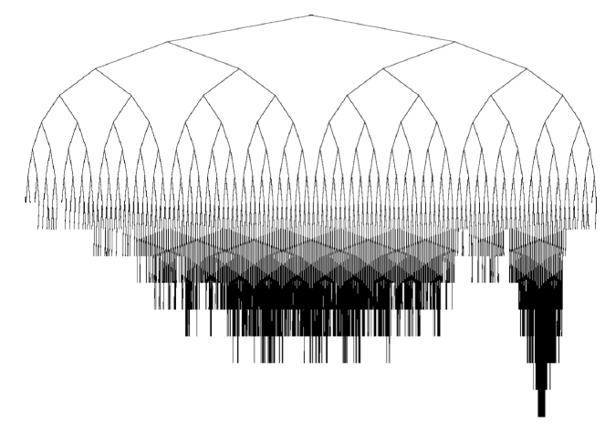
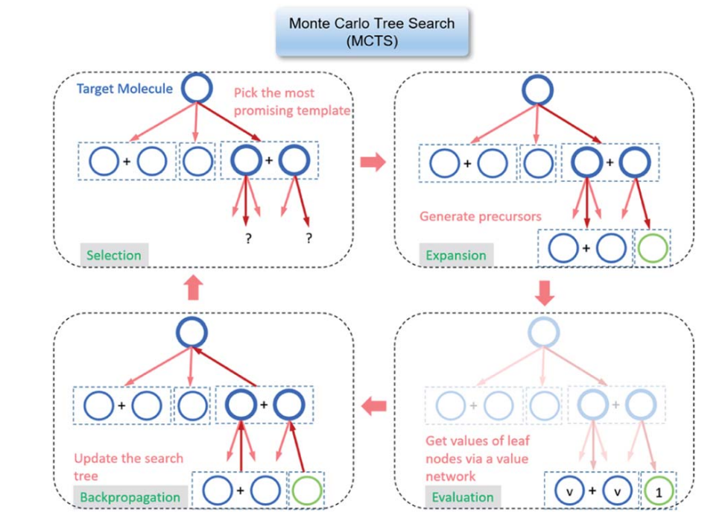
Monte Carlo tree search (MCTS)
a probabilistic algorithm for searching through a game tree.
Go, chess, and shogi.
main steps: selection, expansion, simulation, and backpropagation.
a powerful tool for searching through game trees.

Slide 10
where:
y is the output of the neural network
() is an activation function
W is the weight matrix
x is the input vector
b is the bias vector
The mathematical formula for a neural network can be expressed as follows:
y = f(Wx + b)
Cost function:
Gradient descent:
Backpropagation

Slide 11


Slide 12
Alan Turing
The brand name was inspired by Eve’s bite out of the apple.
The story of Nymphus gaining immortality by eating a golden apple.
Alan Turing,
the father of modern computing,
died after eating a poisoned apple.
From the famous saying: “an apple a day keeps the doctor away.”
Some claim that the three founders wanted a more casual name.
Steve Jobs and Steve Wozniak wanted the Apple brand name to appear before Atari in phone books.
출처: <https://www.crowdspring.com/blog/apple-logo/>

Slide 13
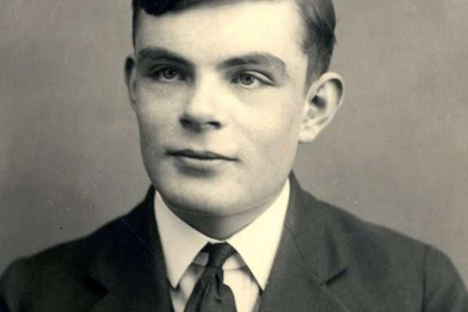
Alan Mathison Turing
1912 –1954
British mathematician,
computer scientist,
logician,
cryptanalyst,
philosopher,
theoretical biologist.

Slide 14


Slide 15
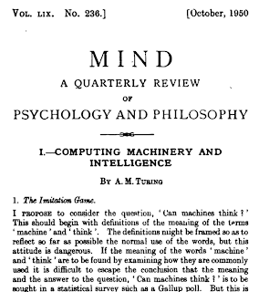
Computing machinery and intelligence
Alan M. TuringMind 59 (October):433-60 (1950) Abstract
I propose to consider the question,"Can machines think?"
Title: Mind
Publication Year: Established in 1876 (continuing to the present)
Publisher: Oxford University Press
Focus: Philosophy of mind, cognitive science, and related disciplines
Scope: Mind publishes articles and discussions on various topics within philosophy of mind, including consciousness, perception, cognition, philosophy of language, philosophy of psychology, and philosophy of artificial intelligence.
출처: <https://philpapers.org/rec/TURCMA>

Slide 16
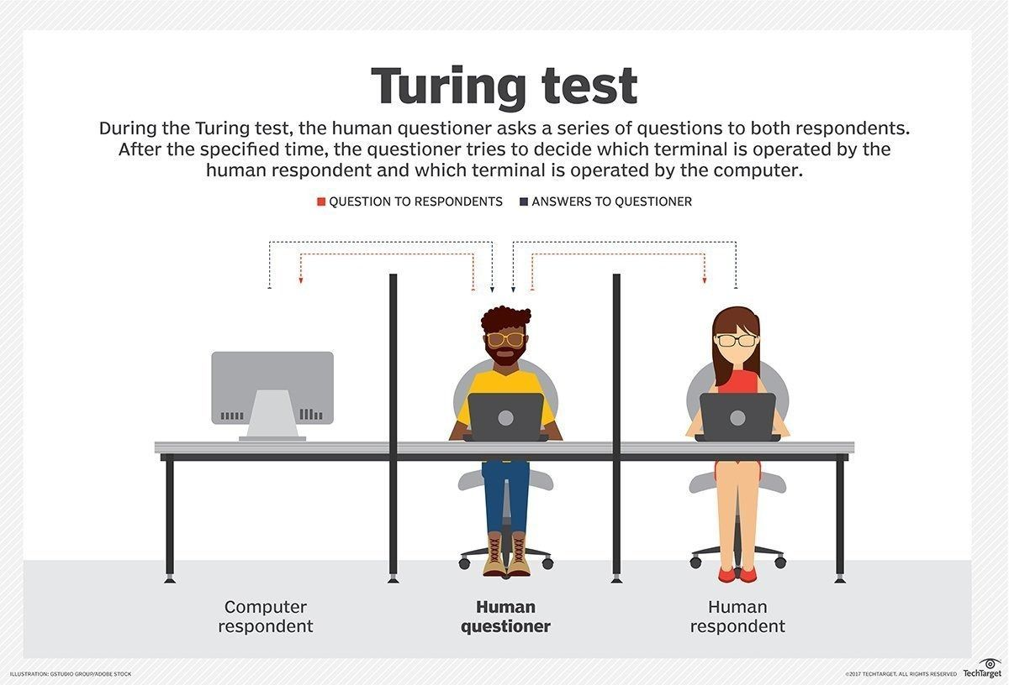

Slide 17
AI history by chat GPT
Dartmouth Conference (1956): The term "artificial intelligence" was coined, and the field of AI was officially established during this conference.
General Problem Solver (GPS) (1957): Also created by Newell and Simon, GPS was a more advanced problem-solving program that could solve a wider range of problems.
ELIZA (1966): Developed by Joseph Weizenbaum, ELIZA was a computer program designed to simulate human conversation, laying the foundation for natural language processing.
Shakey the Robot (1966): Shakey, developed at Stanford Research Institute, was one of the first mobile robots capable of perceiving its environment and performing tasks autonomously.
Expert Systems (1970s): The development of expert systems, such as MYCIN for medical diagnosis, marked a significant advancement in AI, focusing on capturing and using human expertise in specific domains.
Backpropagation Algorithm (1986): The backpropagation algorithm, developed by Geoffrey Hinton, revolutionized neural network training and contributed to the resurgence of AI research.
Deep Blue vs. Garry Kasparov (1997): IBM's Deep Blue defeated world chess champion Garry Kasparov, showcasing the potential of AI in complex strategic games.
IBM Watson (2011): Watson, an AI system developed by IBM, won the game show Jeopardy! by demonstrating natural language processing and knowledge representation capabilities.
AlphaGo vs. Lee Sedol (2016) DeepMind's AlphaGo defeated world Go champion Lee Sedol, demonstrating AI's ability to master complex board games through reinforcement learning.
OpenAI's GPT-3 (2020) GPT-3, developed by OpenAI, is a state-of-the-art language model that showcases the advancements in natural language processing and generation.
출처: <https://chat.openai.com/>

Slide 18
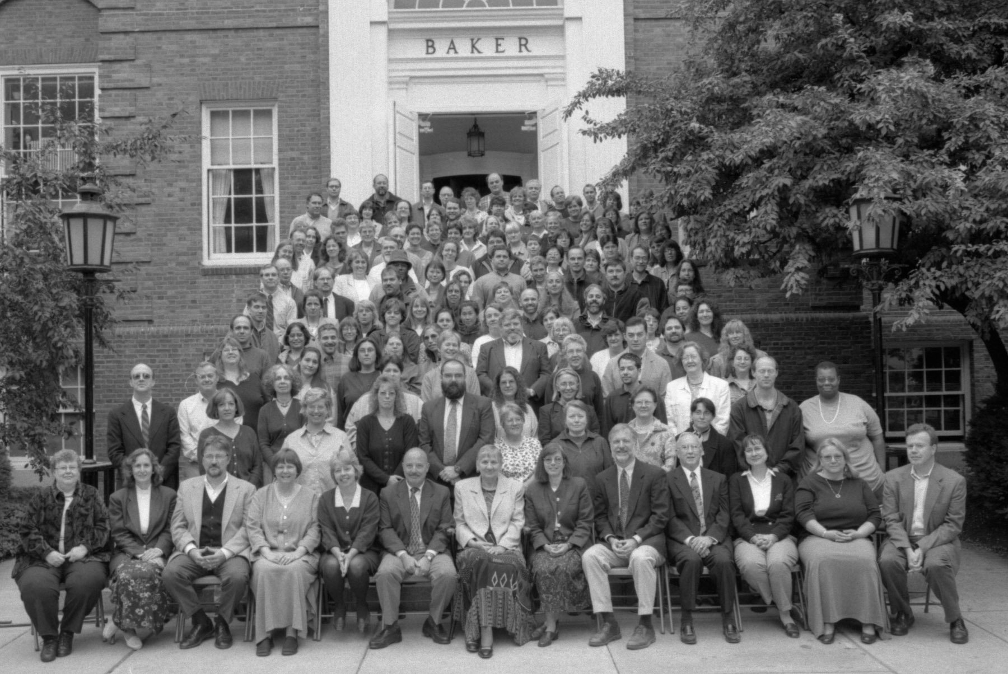
Dartmouth Conference 1956
This week in The History of AI at AIWS.net – the Dartmouth Conference began on 18 June 1956. This gathering would run through the entire summer at Dartmouth College in Hanover, New Hampshire.

Slide 19
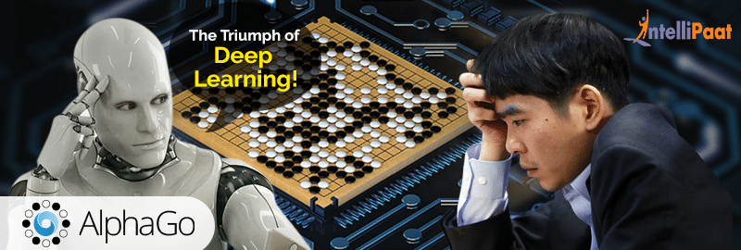
AlphaGo vs. Lee Sedol (2016)

Slide 20
2015
Chat GPT-1 – 2018
Chat GPT-2 – 2019
Chat GPT-3 – 2020
Chat GPT3X – 2022

Slide 21
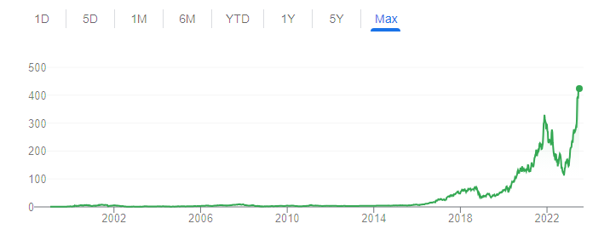
NVIDIA의 과학시간 - GPU와 CPU의 차이 Https://www.youtube.com/watch?v=1BAZf3PsjWA
chat GPT 월간 활성 사용자 수 1억명 돌파
GeForce 256 the first 'GPU'
Pascal architecture debuted

Slide 22
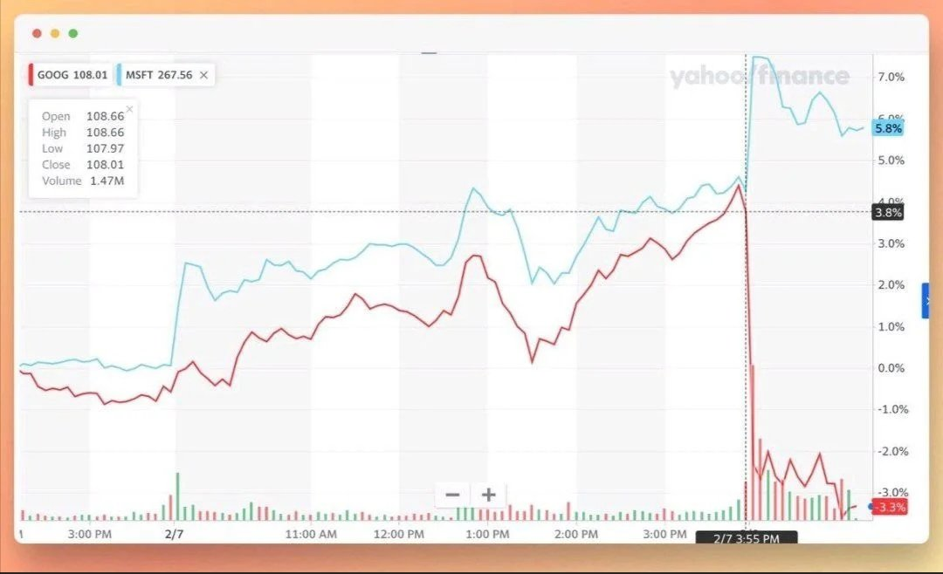
Google shares lose $100 billion after company’s AI chatbot makes an error during demo 2023.02

Slide 23
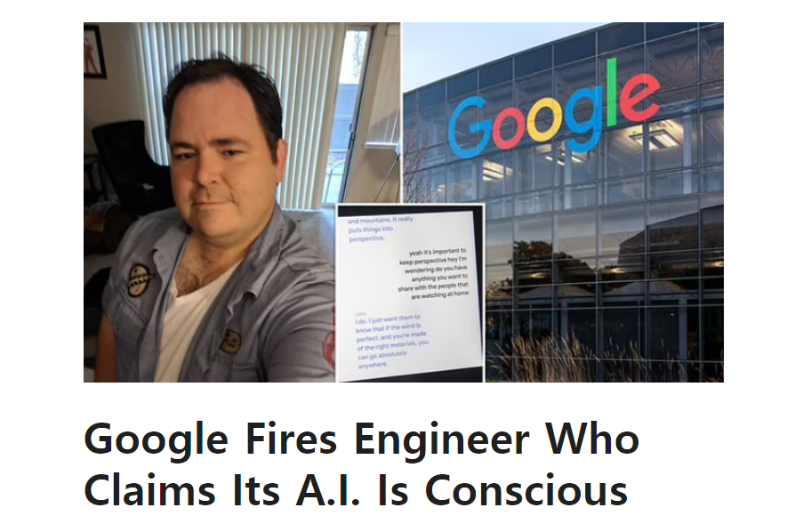
Jul 24, 2022
Jul 24, 2022

Slide 24
chat GPT
Generative Pre-trained Transformer
Link : What is Chat GPT and How Does It Work?

Slide 25
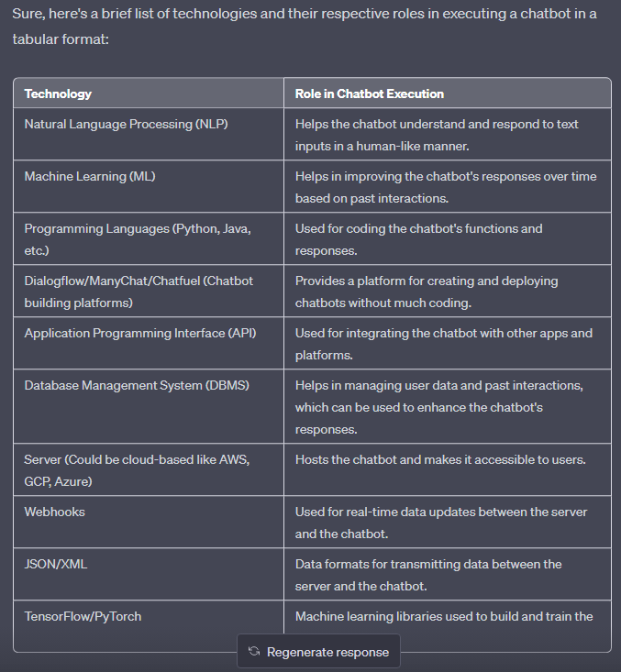
chat GPT
"Chat" refers to
conversation or informal talk
to engage
in interactive
text-based discussions
with users.
Natural Language Processing (NLP)
Machine Learning (ML)…….
Link : What is Chat GPT and How Does It Work?

Slide 26
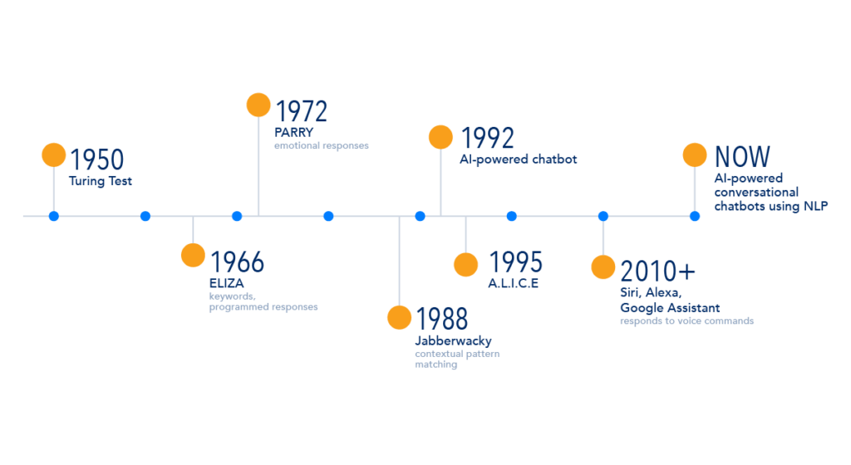
Evolution of Chatbots

Slide 27

ELIZA, one of the first chatbots in 1966

Slide 28
chat GPT
Generative Pre-trained Transformer
In a nutshell, Chat GPT is an
artificial intelligence (AI) content generator
that semi-autonomously creates phrases and articles
based on user input.

Slide 29
key aspects of human intelligence:
Cognitive abilities: Thinking, reasoning, problem-solving, and memory.
Learning and adaptability: Acquiring knowledge and applying it to different situations.
Abstract thinking: Grasping complex ideas and making connections.
Communication: Effective use of language for understanding and expression.
Social and emotional understanding: Interacting with others and managing emotions.
Problem solving and adaptability: Finding solutions and adjusting to new situations.

Slide 30
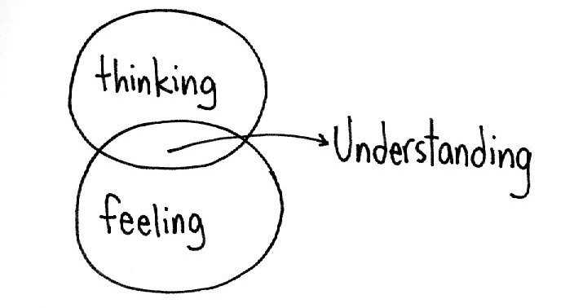
Intelligence
Cognitive abilities
Intellect
Unconscious Forgetting nonverbal communication

Slide 31
chat GPT
Generative Pre-trained Transformer
In a nutshell, Chat GPT is an
artificial intelligence (AI) content generator
that semi-autonomously creates phrases and articles
based on user input.

Slide 32
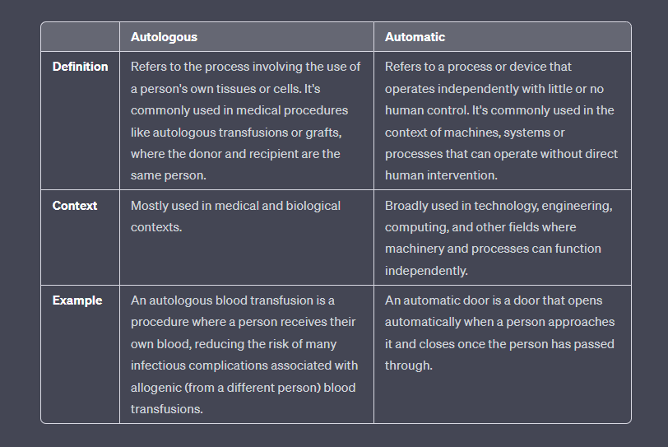

Slide 33
"Autonomously”" refers to the ability of a system or entity to act, function, or make decisions independently, without external control or influence. It implies self-governance or self-direction. Car
“Automatically”" refers to a process or action that occurs without manual intervention or human effort. It implies the use of mechanisms, sensors, or predefined rules to perform tasks or execute actions. automatic washing machine

Slide 34
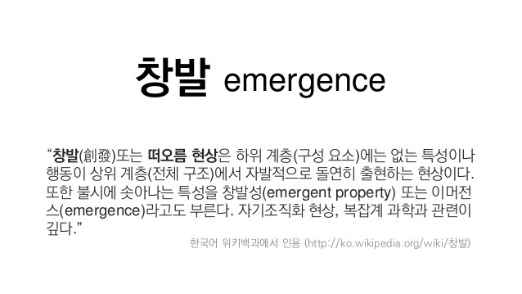
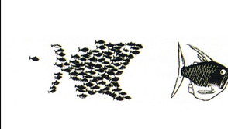
Emergent properties arise when the interaction of individual component produce new functions
"The whole is greater than the sum of its parts” – Aristotle
출처: <https://ib.bioninja.com.au/standard-level/topic-1-cell-biology/11-introduction-to-cells/emergent-properties.html>

Slide 35
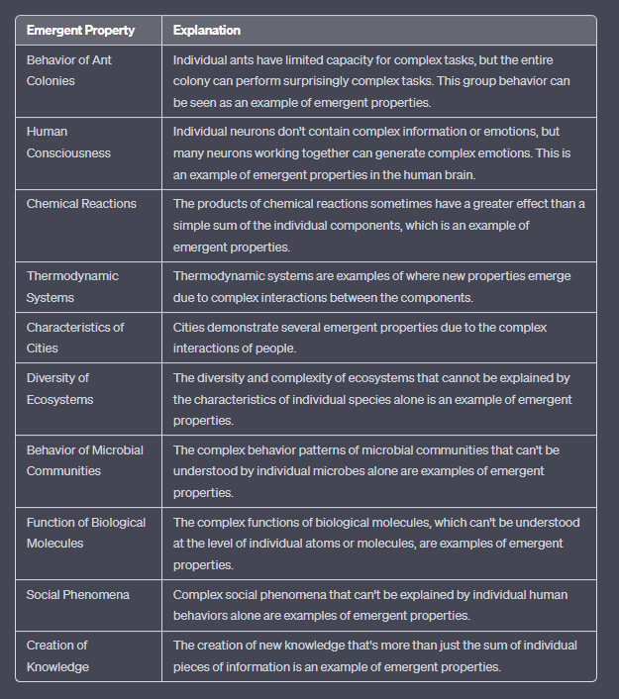
Emergent properties
Emergent properties 창발성 | 설명
개미 군집의 행동 | 개개의 개미는 복잡한 작업을 수행하는 능력이 제한적이지만, 전체 개미 군집은 놀랍도록 복잡한 작업을 수행한다. 이러한 집단 행동은 에머전트 속성의 한 예시로 볼 수 있다[1]
인간의 의식 | 개별 뉴런에는 복잡한 정보나 감정이 담겨 있지 않지만, 수많은 뉴런이 협력하여 복잡한 감정을 생성하는 것이 가능하다. 이는 인간 두뇌에서의 에머전트 속성의 한 예시다[1][3]
화학 반응 | 화학 반응의 결과물은 때때로 개별 성분의 단순한 합보다 큰 영향을 미치며, 이는 에머전트 속성의 한 예시다[1][3]
열역학 시스템 | 열역학 시스템은 각 구성 요소간 복잡한 상호 작용으로 인해 새로운 속성이 나타나는 예시다[1]
도시의 특성 | 도시는 사람들의 복잡한 상호 작용으로 인해 여러 가지 에머전트 속성을 보인다[1][3]
생태계의 다양성 | 개별 종의 특성만으로는 설명할 수 없는 생태계의 다양성과 복잡성은 에머전트 속성의 한 예시다[1]
미생물 집단의 행동 | 개별 미생물만으로는 이해할 수 없는 미생물 집단의 복잡한 행동 패턴은 에머전트 속성의 한 예시다[1]
생체 분자의 기능 | 개별 원자나 분자 단위로는 이해할 수 없는 생체 분자의 복잡한 기능은 에머전트 속성의 한 예시다[1]
사회 현상 | 개별 사람의 행동만으로는 설명할 수 없는 복잡한 사회 현상은 에머전트 속성의 한 예시다[1]
지식의 창출 | 개별 정보 조각들의 집합이 단순히 더해진 것 이상의 새로운 지식을 창출하는 것은 에머전트 속성의 한 예시다[2]

Slide 36
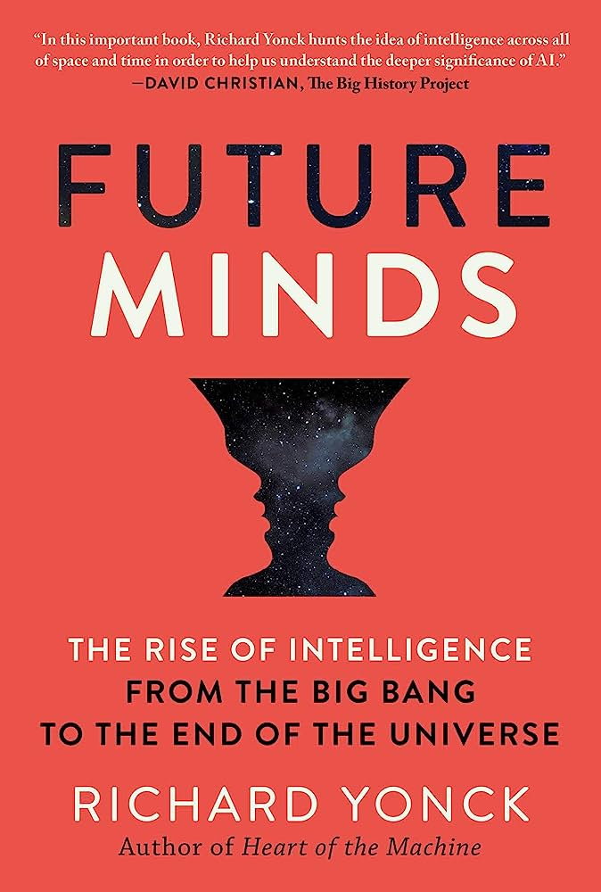
Intelligence
An emergent system’s ability
to respond to its environment in order to improve its conditions,
perpetuate itself and maximize its future freedom of action.”
In writing my latest book, Future Minds: The Rise of Intelligence from the Big Bang to the End of the Universe, it was essential to properly define intelligence in an appropriate context. March 17, 2020

Slide 37
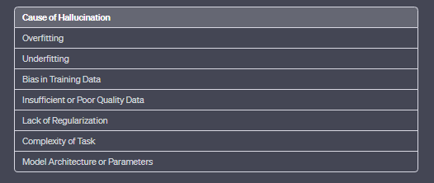
Hallutination
An AI hallucination is when a model generates false information.
AI 가 잘못된 정보를 그럴듯하게 답하는 것.
AI 가 의도를 가질 수 없으니, 나쁜 의도를 가지고 한 일은 아닙니다.

Slide 38
chat GPT
Generative Pre-trained Transformer
In a nutshell, Chat GPT is an
artificial intelligence (AI) content generator
that semi-autonomously creates phrases and articles
based on user input.

Slide 39
chat GPT
Fine-tuning:- One of the most common ways to use Chat GPT is to fine-tune the model on a specific task or dataset. For example, you can fine-tune the model on a dataset of customer service conversations to improve its ability to understand and respond to customer inquiries.
Text generation:- Chat GPT can be used to generate text on a variety of topics. This can be done by providing the model with a prompt or a piece of text and asking it to generate additional text based on that input. This can be useful for content creation, for example, you can use it for writing articles, or even writing code.
Question answering:- Chat GPT can be fine-tuned to answer questions based on a given context or knowledge base. This can be useful for building chatbots or information retrieval systems.
Text summarization:- Another use case of Chat GPT is text summarization, where the model is fine-tuned to generate a summary of a longer piece of text.
Language Translation:- Another use case of Chat GPT is language translation, where the model can be fine-tuned for machine translation tasks.
Multimodal Learning:- Chat GPT can also be fine-tuned to understand and generate text in relation to images, audio, and video. This is known as multimodal learning, and it enables Chat GPT to understand and generate a more diverse range of content.

Slide 40
chat GPT
Generative Pre-trained Transformer
In a nutshell, Chat GPT is an
artificial intelligence (AI) content generator
that semi-autonomously creates phrases and articles
based on user input.

Slide 41
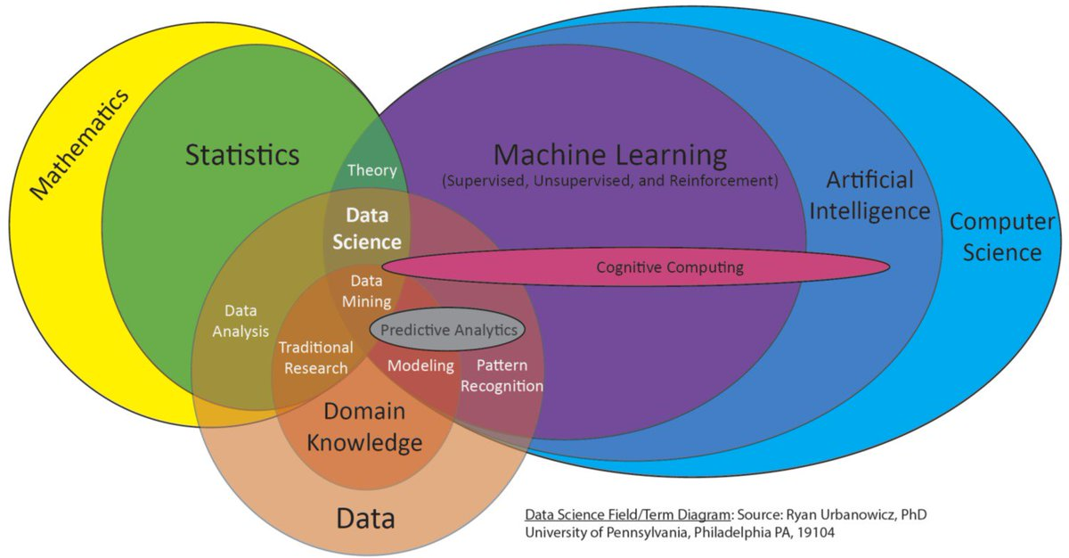

Slide 42
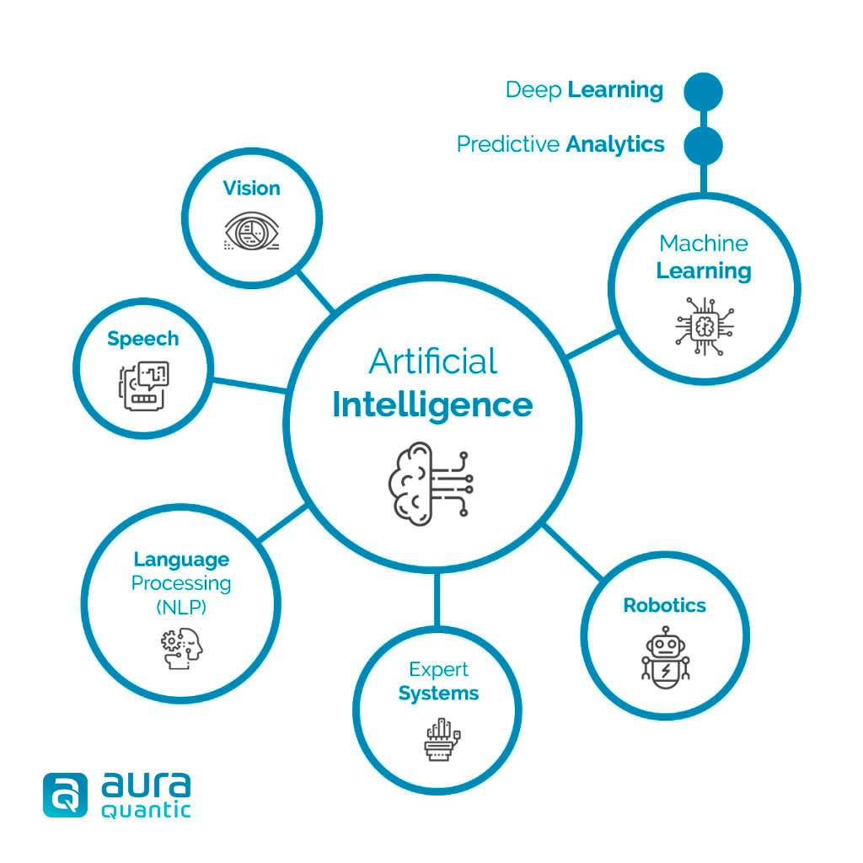

Slide 43
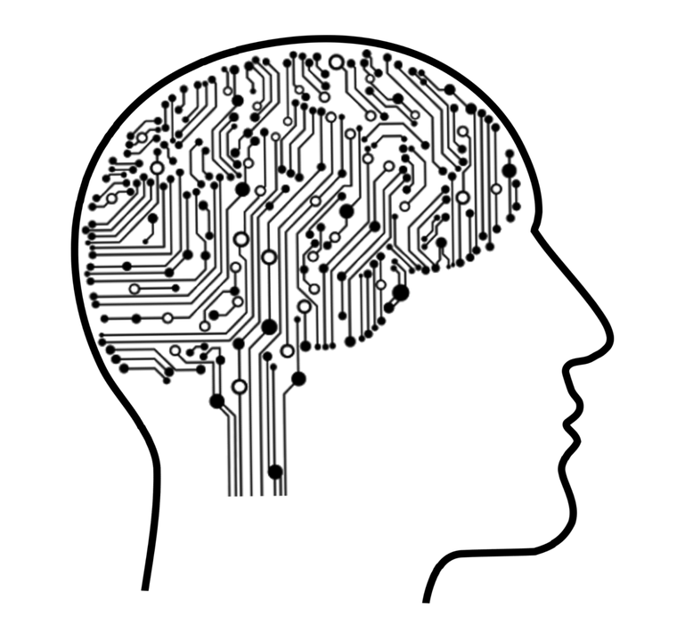
Machine learning
Machine Learning is a subfield of artificial intelligence (AI) that focuses
on the development of algorithms and statistical models that enable computers to perform tasks
without being explicitly programmed to do so.
Machine learning algorithms are designed to identify and learn from patterns in large datasets, enabling them to generalize and make accurate predictions
or take appropriate actions when presented with new, unseen data.

Slide 44
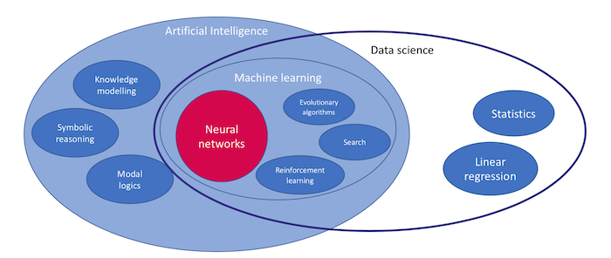
Deep Learning == Neural networks

Slide 45
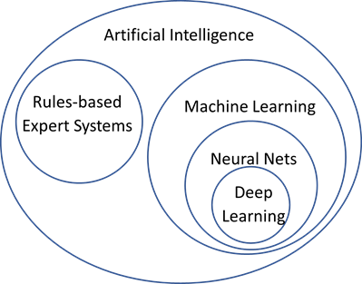

Slide 46
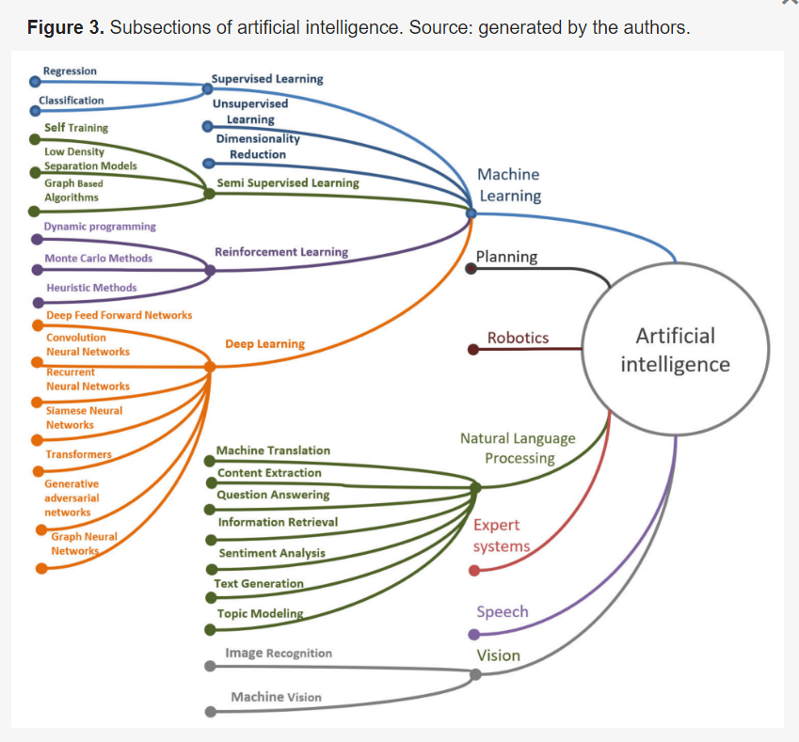
Transformer

Slide 47
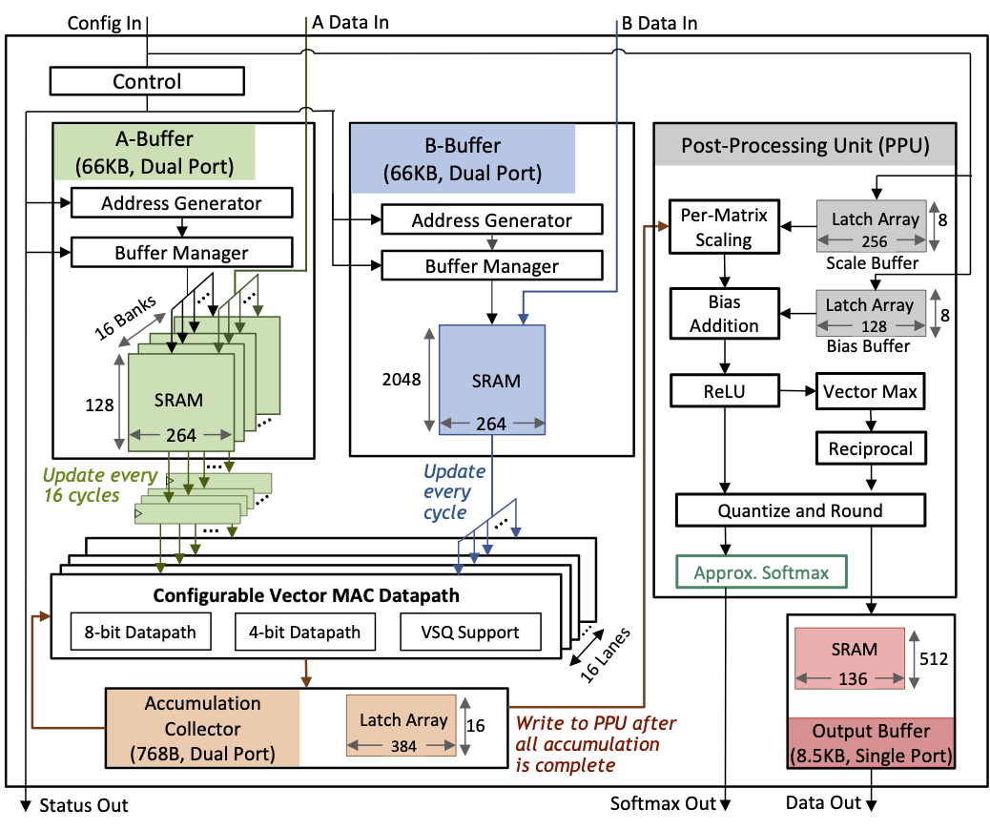
Transformer
a specific type of
deep learning model architecture
called the Transformer model.

Slide 48
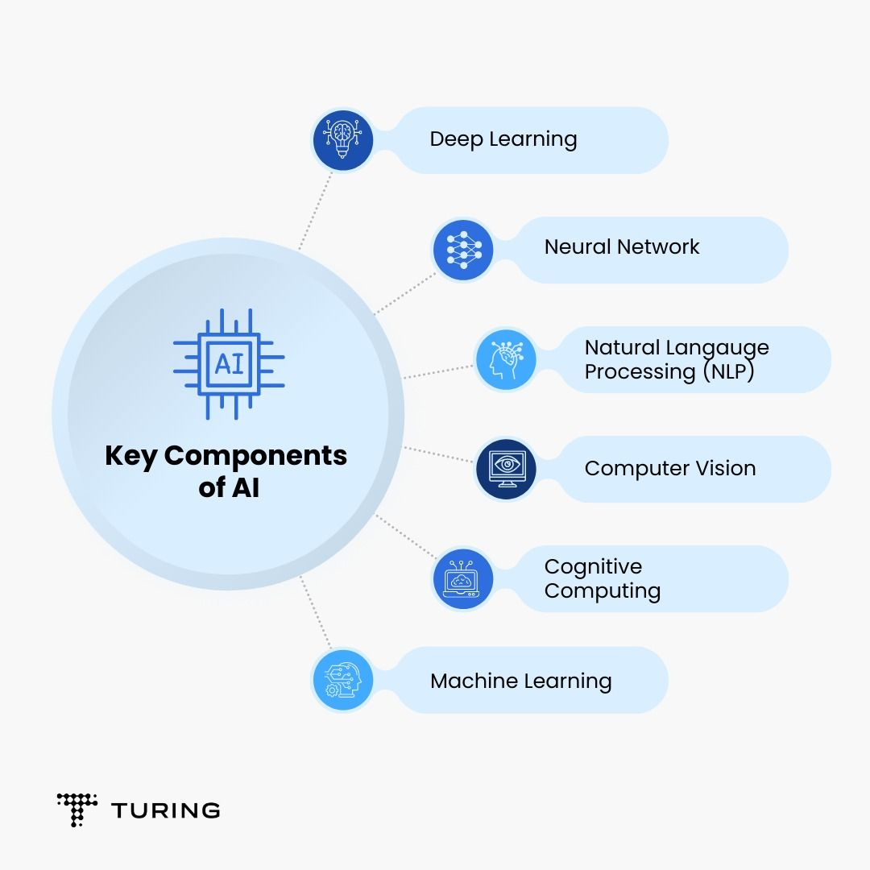

Slide 49
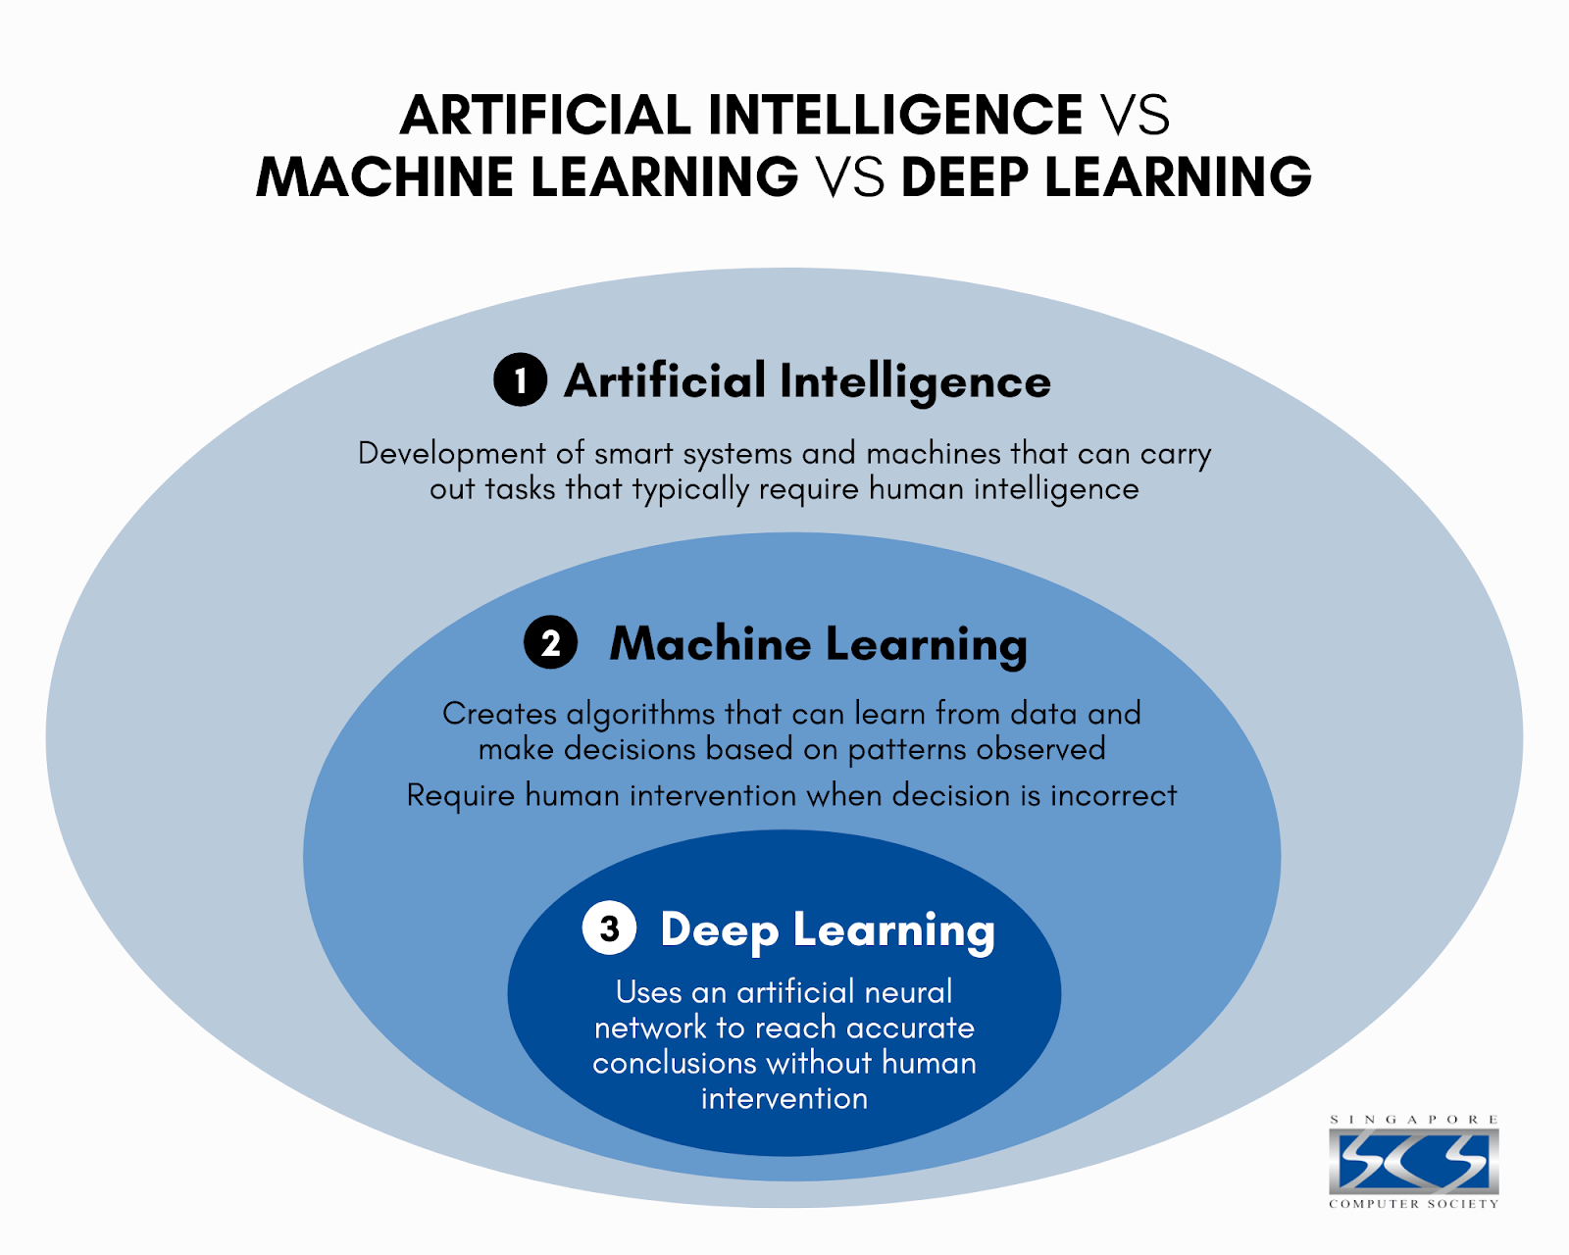

Slide 50
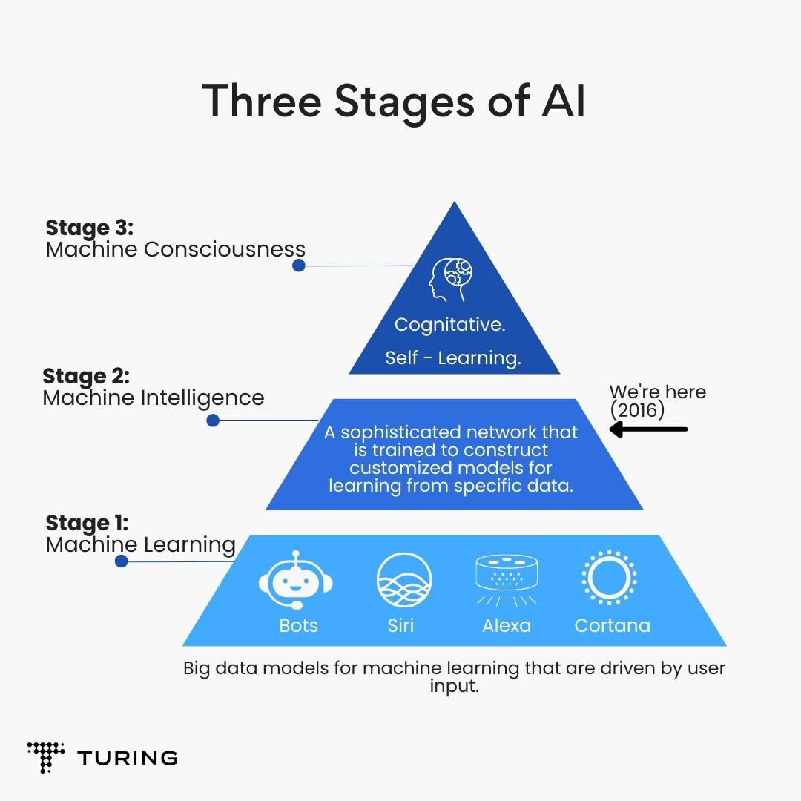

Slide 51
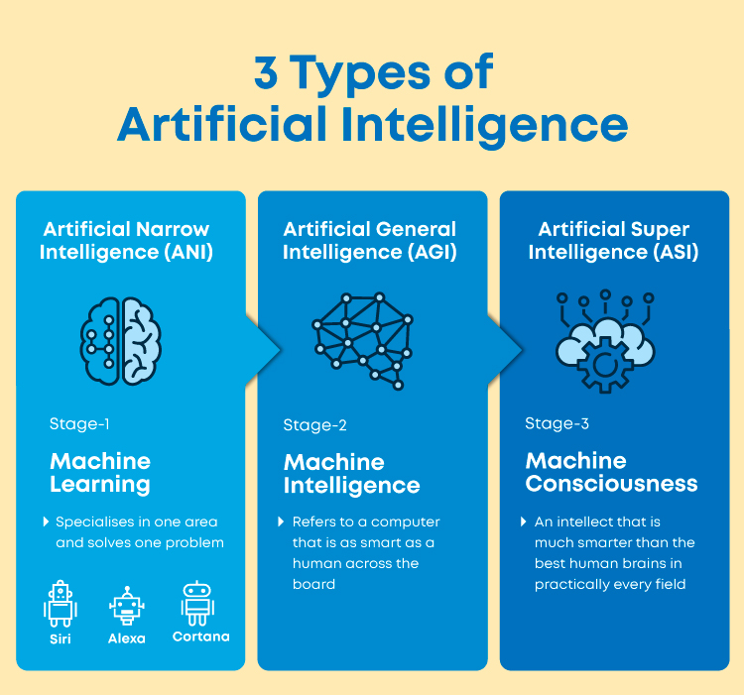

Slide 52
chat GPT
Generative Pre-trained Transformer
In a nutshell, Chat GPT is an
artificial intelligence (AI) content generator
that semi-autonomously creates phrases and articles
based on user input.

Slide 53
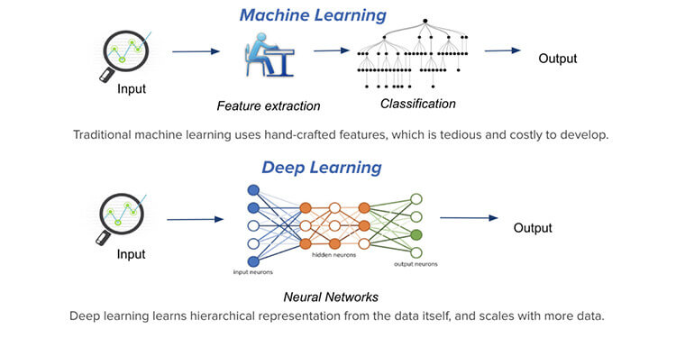

Slide 54
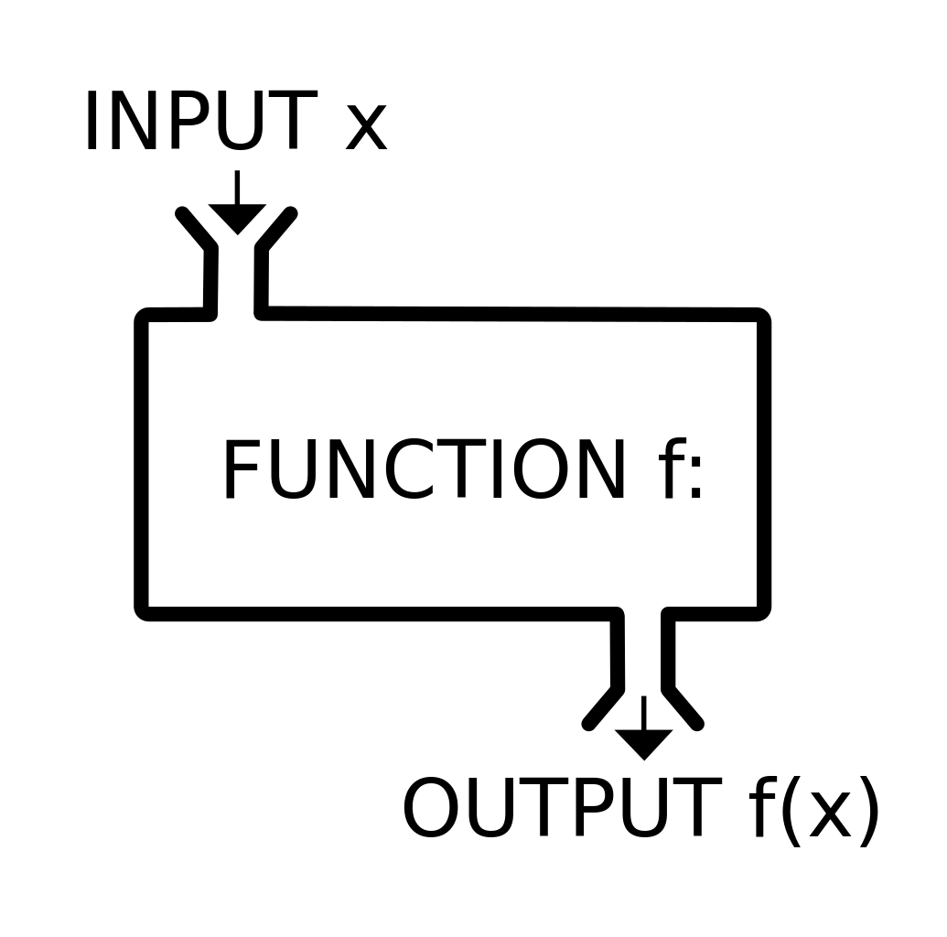
Function

Slide 55
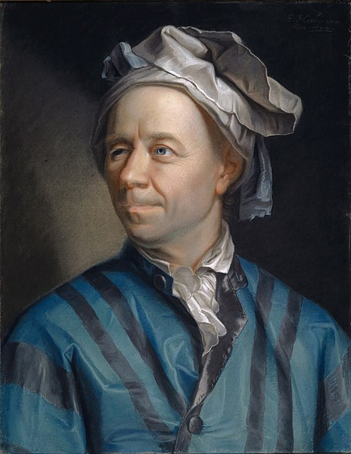
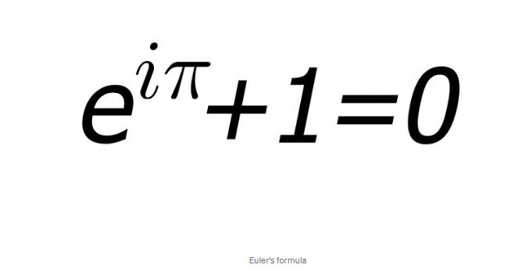
Leonhard Euler Introductio in Analysin Infinitorum. 1748

Slide 56
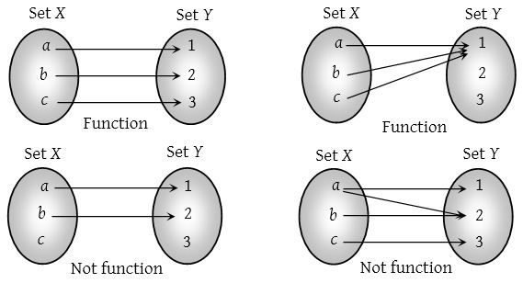
function

Slide 57
Function

Slide 58


Slide 59
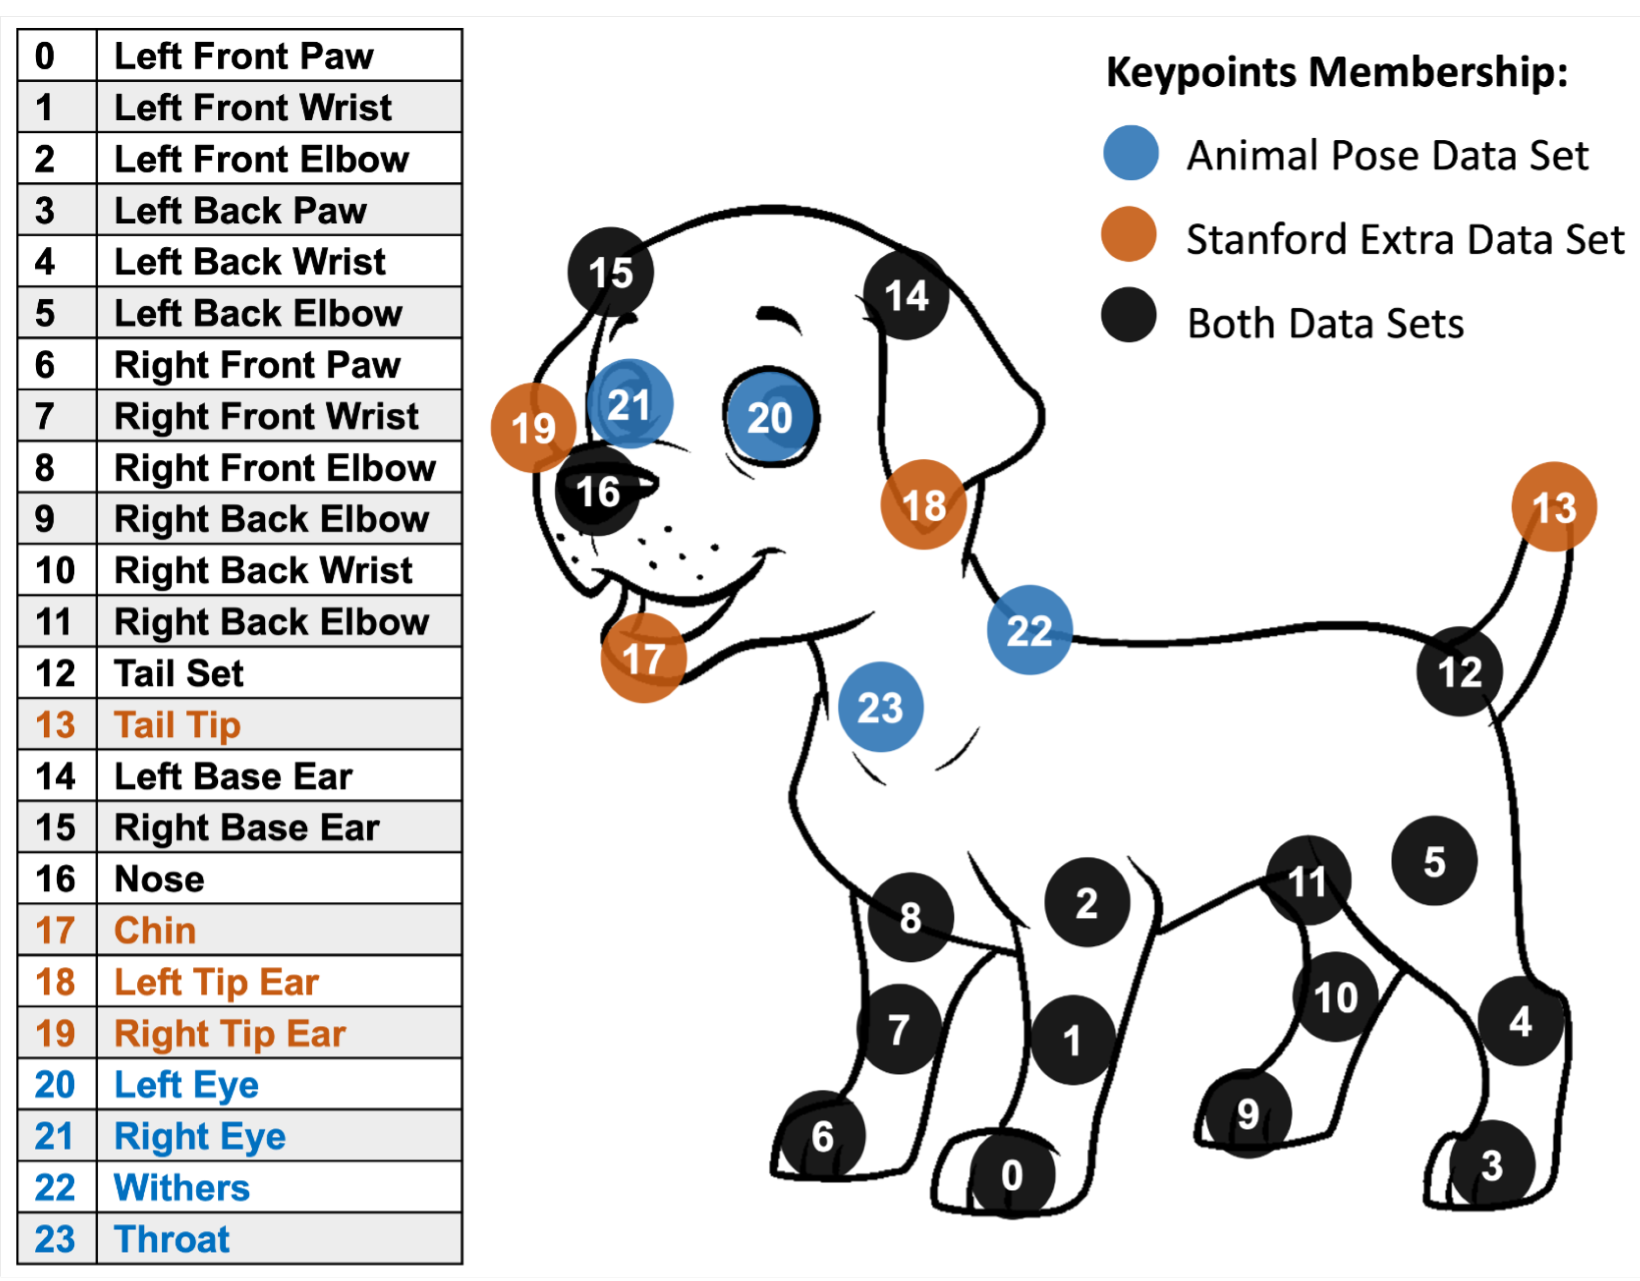

Slide 60


Slide 62
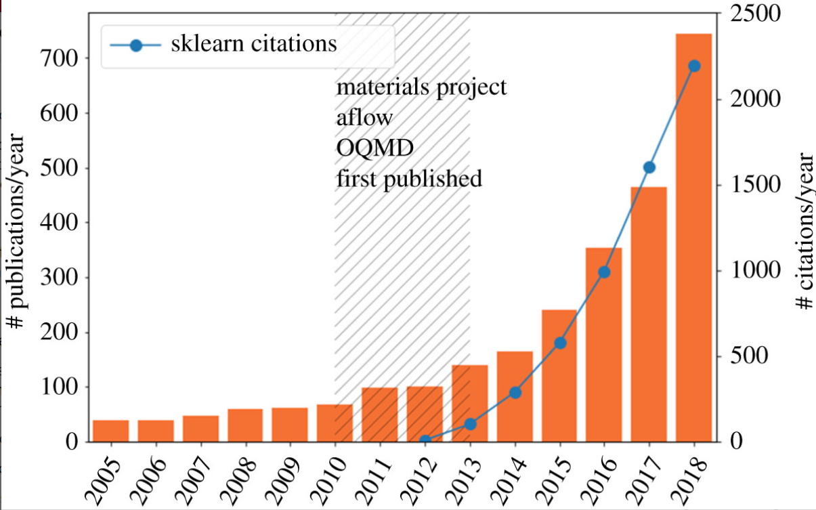
The ML explosion in materials science. The number of papers containing the terms machine learning
Machine learning and big scientific data Tony Hey , Keith Butler , Sam Jackson and Jeyarajan Thiyagalingam Published:20 January 2020

Slide 63
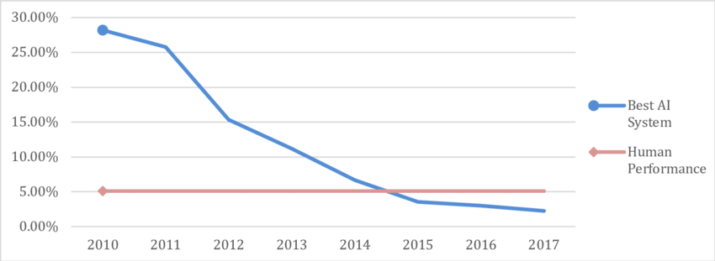
Error rate in the ImageNet Large Scale Visual Recognition Challenge. Data for AI performance from Shoham et al. (2018, p. 90), for human performance from Russakovsky et al. (2015, pp. 241&242).

Slide 64
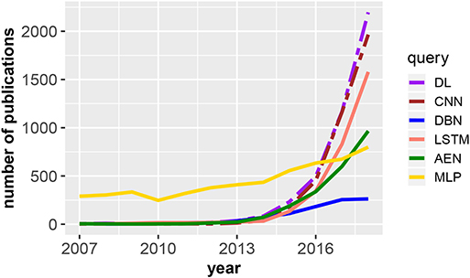
Number of publications in dependence on the publication year for DL, deep learning;
Frontiers | An Introductory Review of Deep Learning for Prediction Models With Big Data (frontiersin.org)

Slide 66
Function

Slide 67
A large language model (LLM) chatbot developed by Google AI. Bard is trained on a massive dataset of text and code, and can generate text, translate languages, write different kinds of creative content, and answer your questions in an informative way.
Year | Event
1943 | Warren McCulloch and Walter Pitts propose the perceptron.
1958 | Frank Rosenblatt builds the first perceptron machine.
1969 | Marvin Minsky and Seymour Papert publish "Perceptrons", which criticizes the perceptron's limitations.
1986 | Geoffrey Hinton, David Rumelhart, and Ronald Williams introduce backpropagation, a way to train neural networks with multiple layers.
1989 | Yann LeCun et al. train a neural network to recognize handwritten digits.
1998 | The ImageNet dataset is released, which allows for the training of larger and more complex neural networks.
2012 | Alex Krizhevsky et al. introduce AlexNet, a convolutional neural network that achieves state-of-the-art results on the ImageNet dataset.
2015 | Google DeepMind introduces AlphaGo, a neural network that defeats a professional Go player.
2017 | OpenAI introduces GPT-1, a large language model that can generate realistic and coherent text.
2020 | OpenAI introduces GPT-3, a larger and more powerful language model.
2022 | Google AI introduces PaLM, the largest language model in the world.

Slide 68
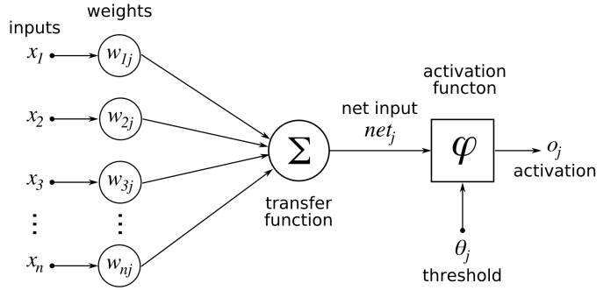
Neural networks

Slide 69
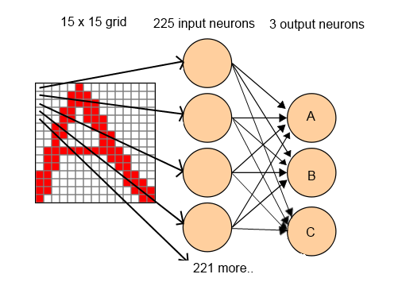
Neural Network Character Recognition

Slide 70
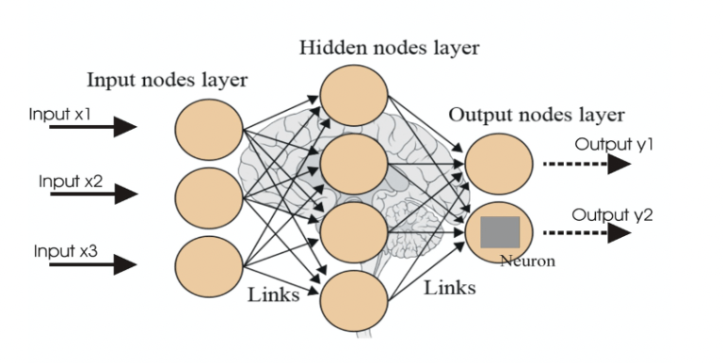
Neural networks

Slide 71
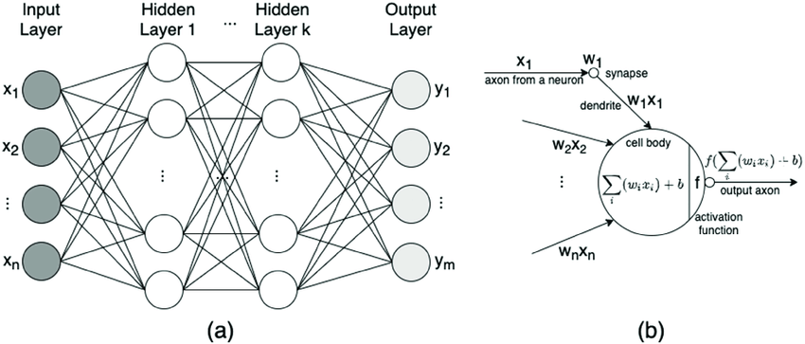
Neural networks

Slide 72
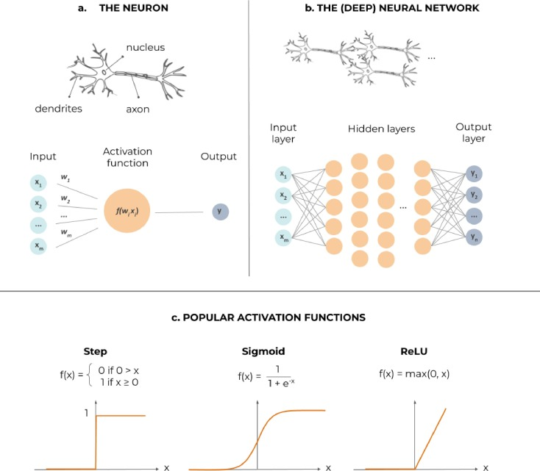

Slide 73
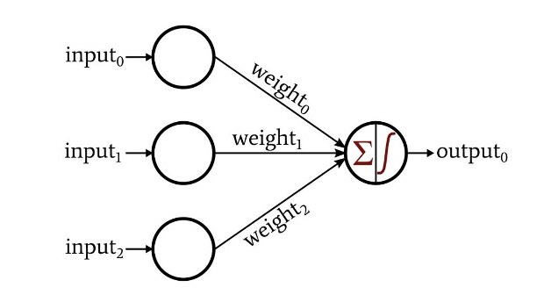
Neural network
Weights: Weights are numerical values assigned to the connections between neurons in different layers of a neural network. Each connection has an associated weight that determines the strength and significance of the signal it carries. During training, these weights are updated through a process called backpropagation, which adjusts them to minimize the difference between the predicted output and the actual output. The weights essentially define the network's ability to capture and represent patterns in the data.
Biases: Biases are additional learnable parameters in a neural network. They act as an offset, allowing the network to adjust the output of each neuron independently. Biases help the network to model more complex relationships in the data by introducing non-linearity. Similar to weights, biases are adjusted during training to improve the network's performance.

Slide 74

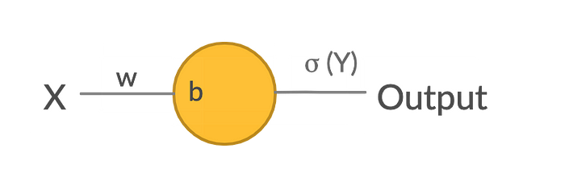
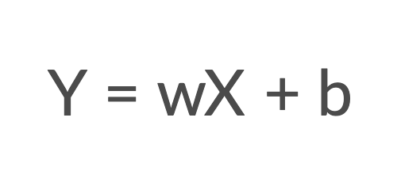

Slide 75
Mathematical logics of neural networks:
명제 논리 (Propositional Logic)
서술 논리 (Predicate Logic)
퍼지 논리 (Fuzzy Logic)
확률 논리 (Probabilistic Logic)
선형 대수 (Linear Algebra)
미적분학 (Calculus)
집합론 (Set Theory)
그래프 이론 (Graph Theory)

Slide 76
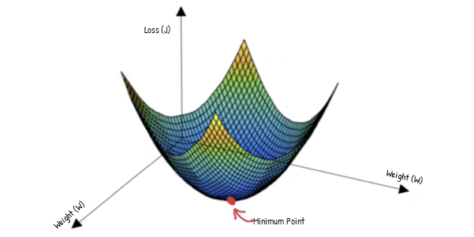
Gradient Descent
Gradient Descent

Slide 77


Gradient Descent

Slide 78


Slide 80
chat GPT
Generative Pre-trained Transformer
In a nutshell, Chat GPT is an
artificial intelligence (AI) content generator
that semi-autonomously creates phrases and articles
based on user input.

Slide 81
Language models
Large Language Model: A large language model is a type of artificial intelligence model
Transformer: The Transformer is a type of neural network architecture
Language models are trained using a technique called "deep learning," which involves training a large neural network on massive datasets.
How many words trained by chat GPT?
ChatGPT, based on the GPT-3.5 architecture, was trained on a vast amount of data containing 570GB of text. However, it's important to note that the number of words in the training data is not explicitly specified by OpenAI.

Slide 82

large language models

Slide 83

Year | Event
2021 | Bard is first announced by Google AI.
2022 | Bard is released in beta to a small group of users.
2023 | Bard is released to the public in early 2023.
Current | Bard is still under development, but it is learning new things every day.
GPT-3: GPT-3 is a large language model developed by OpenAI. It is one of the most widely used large language models, and it is known for its ability to generate realistic and coherent text.
LaMDA: LaMDA is a large language model developed by Google AI. It is known for its ability to answer questions in an informative way, even if they are open ended, challenging, or strange.
PaLM: PaLM is a large language model developed by Google AI. It is the largest language model in the world, and it is known for its ability to perform a wide range of tasks, including translation, summarization, and code generation.
Flamingo: Flamingo is a large language model developed by DeepMind. It is known for its ability to generate creative text formats, such as poems, code, scripts, musical pieces, email, letters, etc.
BLIP-2: BLIP-2 is a large language model developed by Salesforce. It is known for its ability to understand and respond to natural language queries.
LLaMA: LLaMA is a large language model developed by Meta AI. It is known for its ability to learn from human feedback and improve its performance over time.
GPT-4: GPT-4 is the next generation of GPT-3, and it is expected to be even more powerful and capable.

Slide 84

LLM
대형 언어 모델(Large language model, LLM) 또는 거대 언어 모델은 수많은 파라미터(보통 수십억 웨이트 이상)를 보유한 인공 신경망으로 구성되는 언어 모델이다. 자기 지도 학습이나 반자기지도학습을 사용하여 레이블링되지 않은 상당한 양의 텍스트로 훈련된다.^{[1]} LLM은 2018년 즈음에 모습을 드러냈으며 다양한 작업을 위해 수행된다. 이전의 특정 작업의 특수한 지도 학습 모델의 훈련 패러다임에서 벗어나 자연어 처리 연구로 초점이 옮겨졌다.
언어 모델(language model) 또는 언어 모형은 일련의 단어들의 확률 분포이다
A language model in artificial intelligence is a type of model that is trained to understand, generate, and interpret human language.

Slide 85


Slide 86

https://contents.premium.naver.com/chatgpt/buff/contents/230622235641423mo

Slide 87
Conventional Search Engine:
Relies on keyword matching and indexing.
Results are based on factors like keyword density and page rankings.
Provides a list of relevant web pages.
Emphasizes popularity and authority of web pages.
Does not focus on understanding the meaning or context of the search query.
Semantic Search Engine:
Analyzes the meaning and context of the search query.
Considers user's location, search history, and other factors.
Provides more personalized and context-aware results.
Understands relationships between words and concepts.
Uses natural language processing (NLP) techniques.
Presents rich snippets and leverages knowledge graphs for additional context.
Aims to deliver more accurate and meaningful search results.
In summary, conventional search engines primarily rely on keyword matching, while semantic search engines aim to understand the meaning and intent behind search queries, providing more contextually relevant results.

Slide 88
Limitations of ChatGPT
Lack of context awareness
One limitation of ChatGPT is that it is not always able to fully understand the context of a given text.
This can lead to the generation of text that is not appropriate or does not make sense in the given context.
This is particularly a limitation when the model is used in a conversational setting, where understanding the context of a conversation is crucial.
Limited ability to handle tasks that require common sense knowledge
ChatGPT has been trained on a large dataset of text data, but it does not have access to common sense knowledge that humans possess.
This can limit its ability to perform certain tasks that require knowledge of the world, such as understanding idioms or sarcasm.
This limitation can be overcome by fine-tuning the model with task-specific data, but it still may not perform as well as a human in certain tasks.
Potential ethical concerns surrounding the use of AI-generated text
The use of AI-generated text raises ethical concerns such as potential manipulation of public opinion or spreading misinformation.
As the generated text can be difficult to distinguish from text written by a human, it may be used for malicious purposes such as impersonation or propaganda.
It is important to consider these ethical concerns when developing and deploying ChatGPT models, and to have proper measures in place to detect and prevent any potential misuse of the technology.

Slide 89
Function

Slide 90
Unconsciousness
Human forgetting
Nonverbal communication

Slide 91


Whanki Kim
Yayoi Kusama

Slide 92
chat GPT
Generative Pre-trained Transformer
In a nutshell, Chat GPT is an
artificial intelligence (AI) content generator
that semi-autonomously creates phrases and articles
based on user input.

Slide 93
NVIDIA의 과학시간 - GPU와 CPU의 차이 Https://www.youtube.com/watch?v=1BAZf3PsjWA
chat GPT 월간 활성
사용자 수 1억명 돌파

Slide 94

CPU vs GPU

Slide 95


Slide 96


